Slide 1
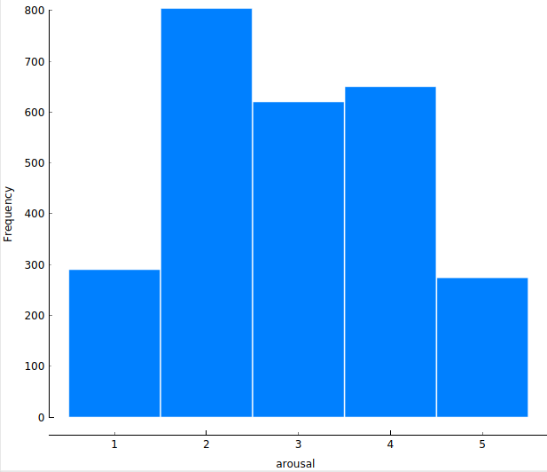
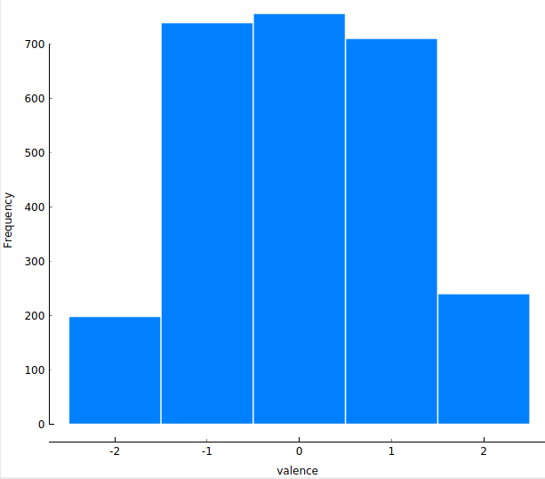
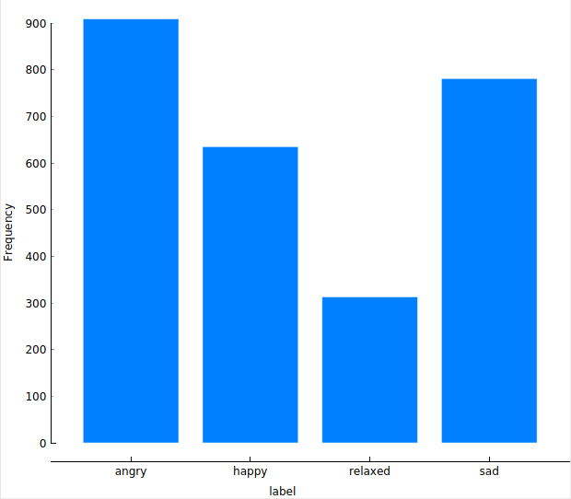
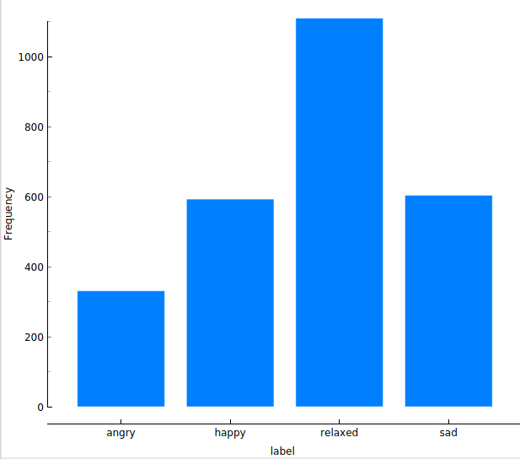
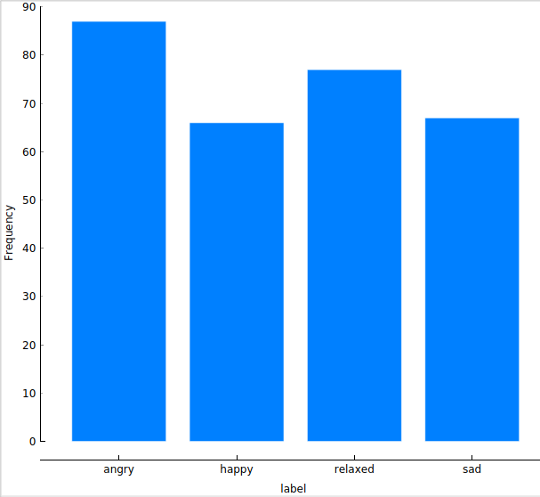
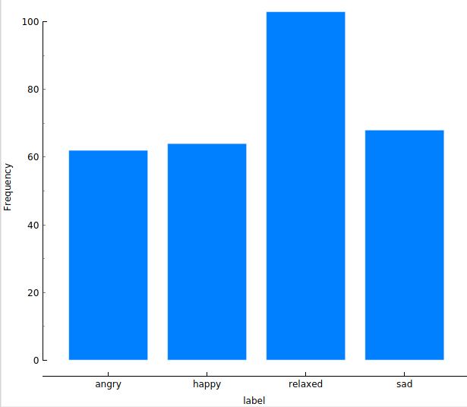
Data Exploration / derive quadrant-based labels
Distribution of arousal and valence in raw annotation data:
Looks a bit of gaussian normal distribution.
So it is important how the middle values are classified.
Overall means: arousal: 2.93, valence: 0.02.
Therefore we have decided
on the following classification:
Angry: arousal >= 3, valence <= 0
Happy: arousal >=3, valence > 0
Sad: arousal < 3, valence <= 0
Relaxed: arousal < 3, valence > 0
A slightly different classification results
in a total different distribution:
Angry: arousal > 3, valence = 0
Happy: arousal > 3, valence >= 0
Sad: arousal <= 3, valence = 0
Relaxed: arousal <= 3, valence >= 0
To label the aggregated data over all annotators, there are many possibilities. We can take the median of arousal and valence
or we can do a majority vote over the raw labels. But in both cases, the result is very dependent on the assignment of the
values 3 and 0 for arousal and valence respectively.
So we decided to take the mean of arousal and valence over all annotators and we assign the values 3 and 0 in such
a way that the distribution is as balanced as possible.
With the mean-value not in the „=“
Angry: arousal >= 3, valence <= 0
Happy: arousal >=3, valence > 0
Sad: arousal < 3, valence <= 0
Relaxed: arousal < 3, valence > 0
Not so balanced, if the mean-value
is in the range with „=“:
Angry: arousal > 3, valence = 0
Happy: arousal > 3, valence >= 0
Sad: arousal <= 3, valence = 0
Relaxed: arousal <= 3, valence >= 0
Conclusion: First we aggregate the raw data and derive the labels from the mean of arousal and valence.

